Slide 1

NLP Resume Extraction
11/30/2023

Slide 2

Team
Name: Ritu Kukreja
Email: rk977@drexel.edu
Country: United States
College/Company: Drexel University

Slide 3
Agenda
Executive Summary
Problem Statement
Approach
EDA
EDA Summary
Model Selection
Recommendations

Slide 4
Executive Summary
My project, titled "NLP Resume Extraction" revolves around the exploration and analysis of a dataset. We'll highlight key patterns and insights obtained from the data exploration and modeling, offering a quick glimpse into the main findings.

Slide 5
Problem Statement
The challenge lies in extracting relevant information from resumes and predicting experience levels accurately. By identifying crucial features and patterns, I aim to develop a model that can efficiently classify professionals into distinct experience categories based on available resume data.

Slide 6
Approach
My approach involves two main steps: Exploratory Data Analysis (EDA) and Model Selection. EDA helps me to understand the characteristics of the data, while Model Selection guides me in choosing the most effective algorithms for predicting experience levels.

Slide 7
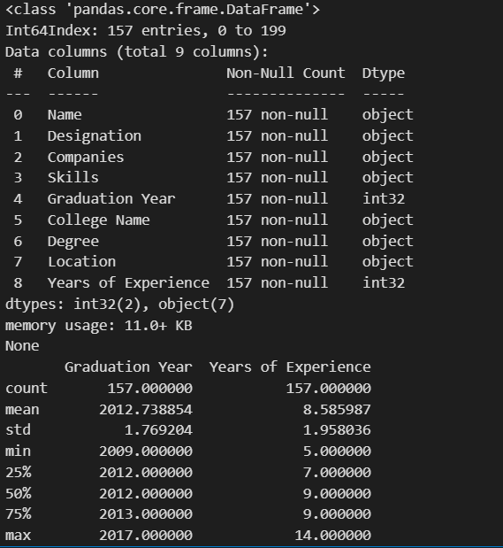
EDA (Exploratory Data Analysis)
Summary Statistics
I initiated the exploration by computing summary statistics, providing an overview of the dataset's composition and structure.
# Task 1: Summary Statistics
print(resume_df.info())
print(resume_df.describe())

Slide 8
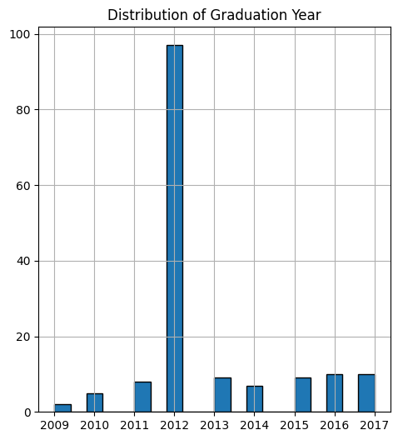
EDA (Exploratory Data Analysis)
Distribution of Numerical Features
Visualizing the distribution of numerical features like 'Graduation Year' allows us to understand the temporal aspects of the dataset.

Slide 9
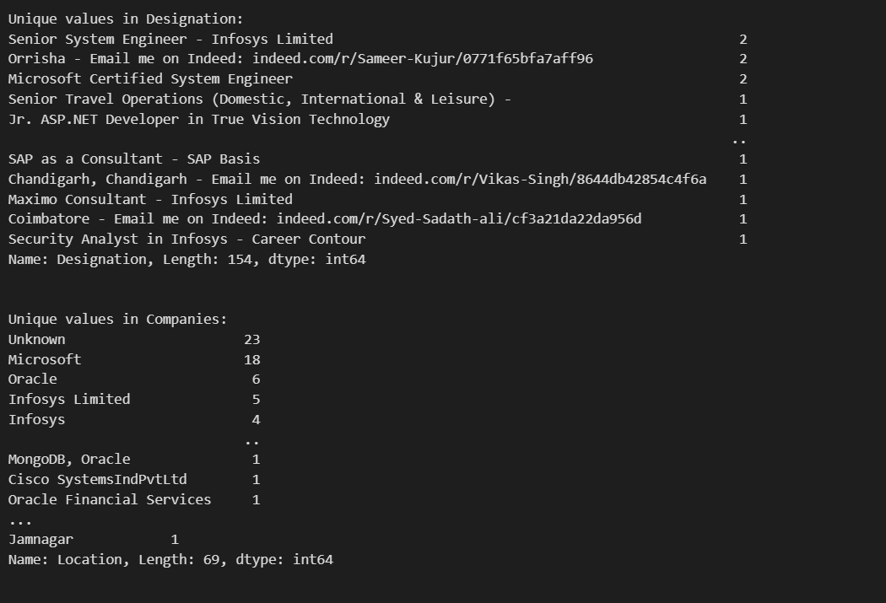
EDA (Exploratory Data Analysis)
Categorical Feature Exploration
Exploring categorical features such as 'Designation,' 'Companies,' 'Skills,' 'College Name,' 'Degree,' and 'Location' unveils insights into the diversity and prevalence of different categories.

Slide 10
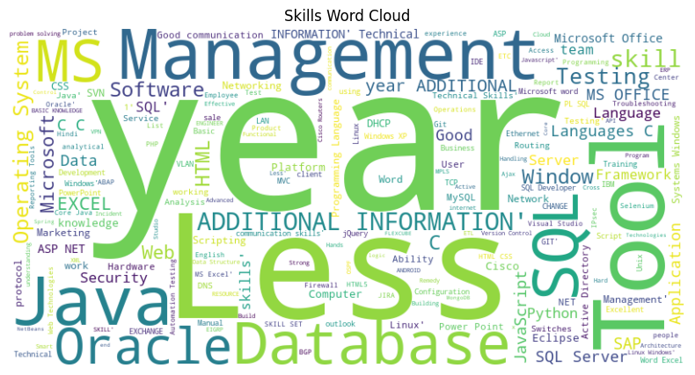
EDA (Exploratory Data Analysis)
Skills Analysis (Word Cloud)
A Word Cloud analysis of skills offers a visual representation of the most frequently mentioned skills in the dataset.

Slide 11
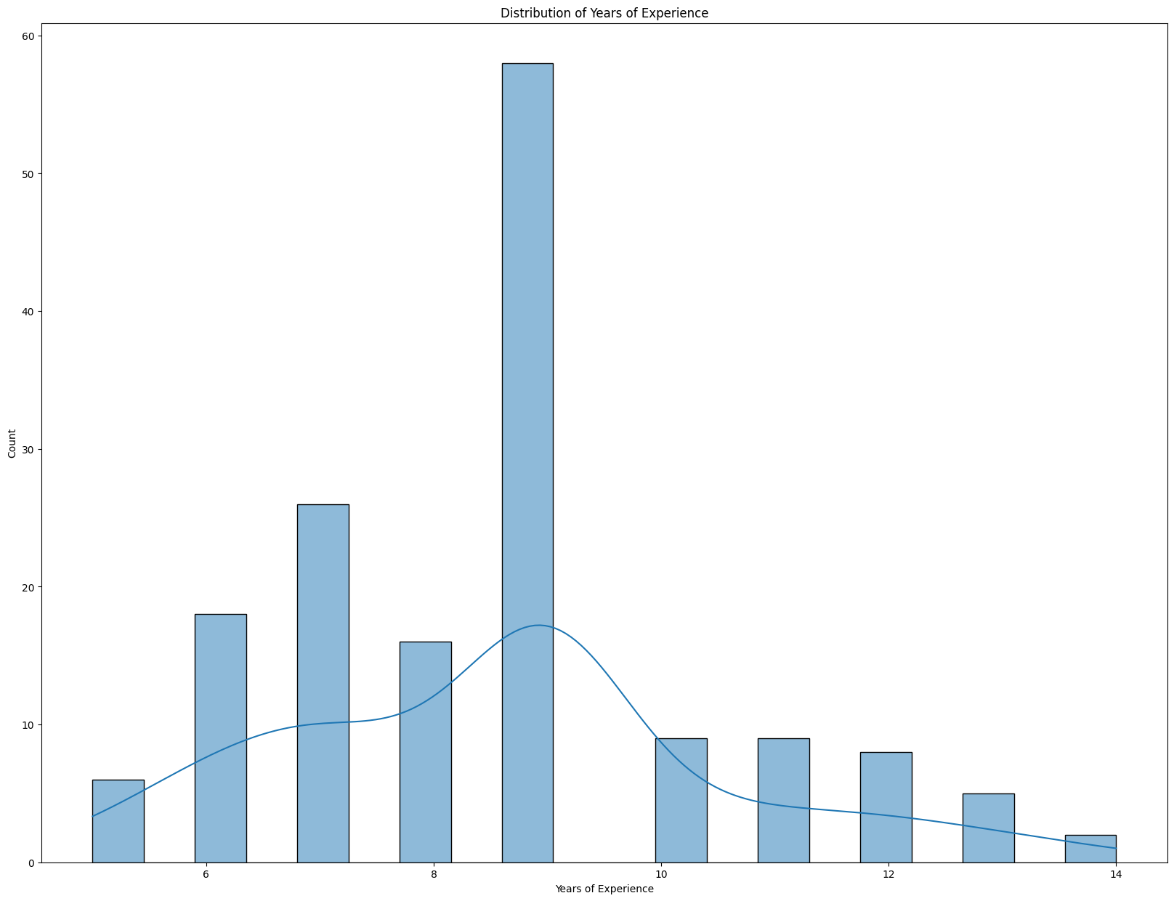
EDA (Exploratory Data Analysis)
Experience Analysis
Analyzing the distribution of 'Years of Experience' provides insights into the workforce's experience levels.

Slide 12
EDA Summary
The EDA process has provided valuable insights into the dataset's composition, revealing trends and patterns that can inform strategic decisions. Key findings include the distribution of skills, geographic preferences, and the prevalence of professionals from top companies and educational institutions.

Slide 13
Model Selection
Logistic Regression (Base Model):
Accuracy: 96.88%
Interpretability: Logistic regression is a simple and interpretable model, making it easy to understand the relationship between features and predictions. However, it may struggle with capturing complex patterns.

Slide 14
Model Selection
Random Forest (Ensemble Model):
Accuracy: 93.75%
Interpretability: Random Forest is an ensemble model known for its robustness and ability to handle complex relationships. While it provides good accuracy, its ensemble nature might make it less interpretable than logistic regression.

Slide 15
Model Selection
Gradient Boosting (Boosting Model):
Accuracy: 100.00%
Interpretability: Gradient Boosting performs exceptionally well in terms of accuracy. It sequentially improves weak learners, resulting in a powerful model. However, this might raise concerns about overfitting, especially if the dataset is not extensive.

Slide 16
Model Selection
Support Vector Machine (SVM):
Accuracy: 84.38%
Interpretability: SVM is effective in capturing intricate patterns in high-dimensional spaces. However, the lower accuracy compared to other models could be a trade-off for increased interpretability.

Slide 17
Recommendations
Best Model: Gradient Boosting
While all models show strong performance, Gradient Boosting stands out with perfect accuracy. However, there is a need for caution, as achieving 100% accuracy might indicate overfitting, especially if the dataset is limited. Further evaluation on different datasets and thorough cross-validation is recommended.
Considerations:
Logistic Regression provides a good balance between accuracy and interpretability.
Random Forest offers a robust solution for capturing complex patterns.
SVM, while slightly less accurate, might be preferred if interpretability is a top priority.

Slide 18
Thank You

